Slide 1

Group 6-2-2
Sports: Activity Performance Tracking
Mahidhar Reddy Dwarampudi
Anirudh Varadarajan
Edward Wong
Sai Prasanna Kumar Vadnala
Zuoan He
Report Document: https://docs.google.com/document/d/1FpfP64P9lnYSjLzwzr3vKUGI2tLQHUizrNEwViXrSzM/

Slide 2
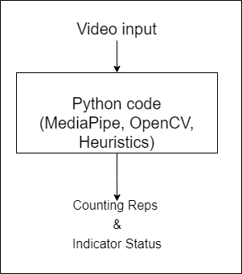
Tight Coupling with Heuristics
Cannot be replicated on different platforms
Major changes for minor additions in heuristics
Hard to replicate, reuse

Slide 3
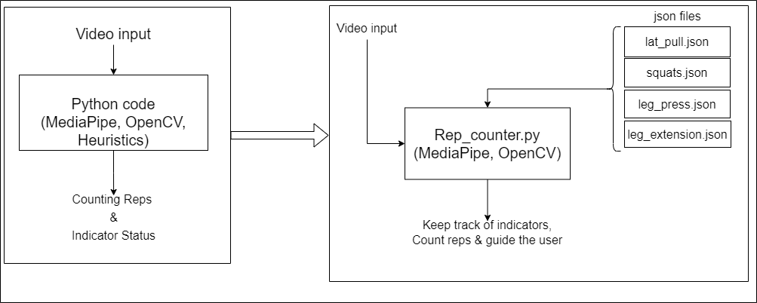

Slide 4
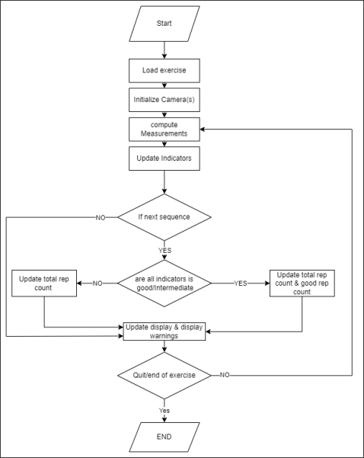
Dynamically adapt to Exercise/cameras
Easily switch between frameworks
Collects data
One size fits all
Generalizes the rep counting

Slide 5
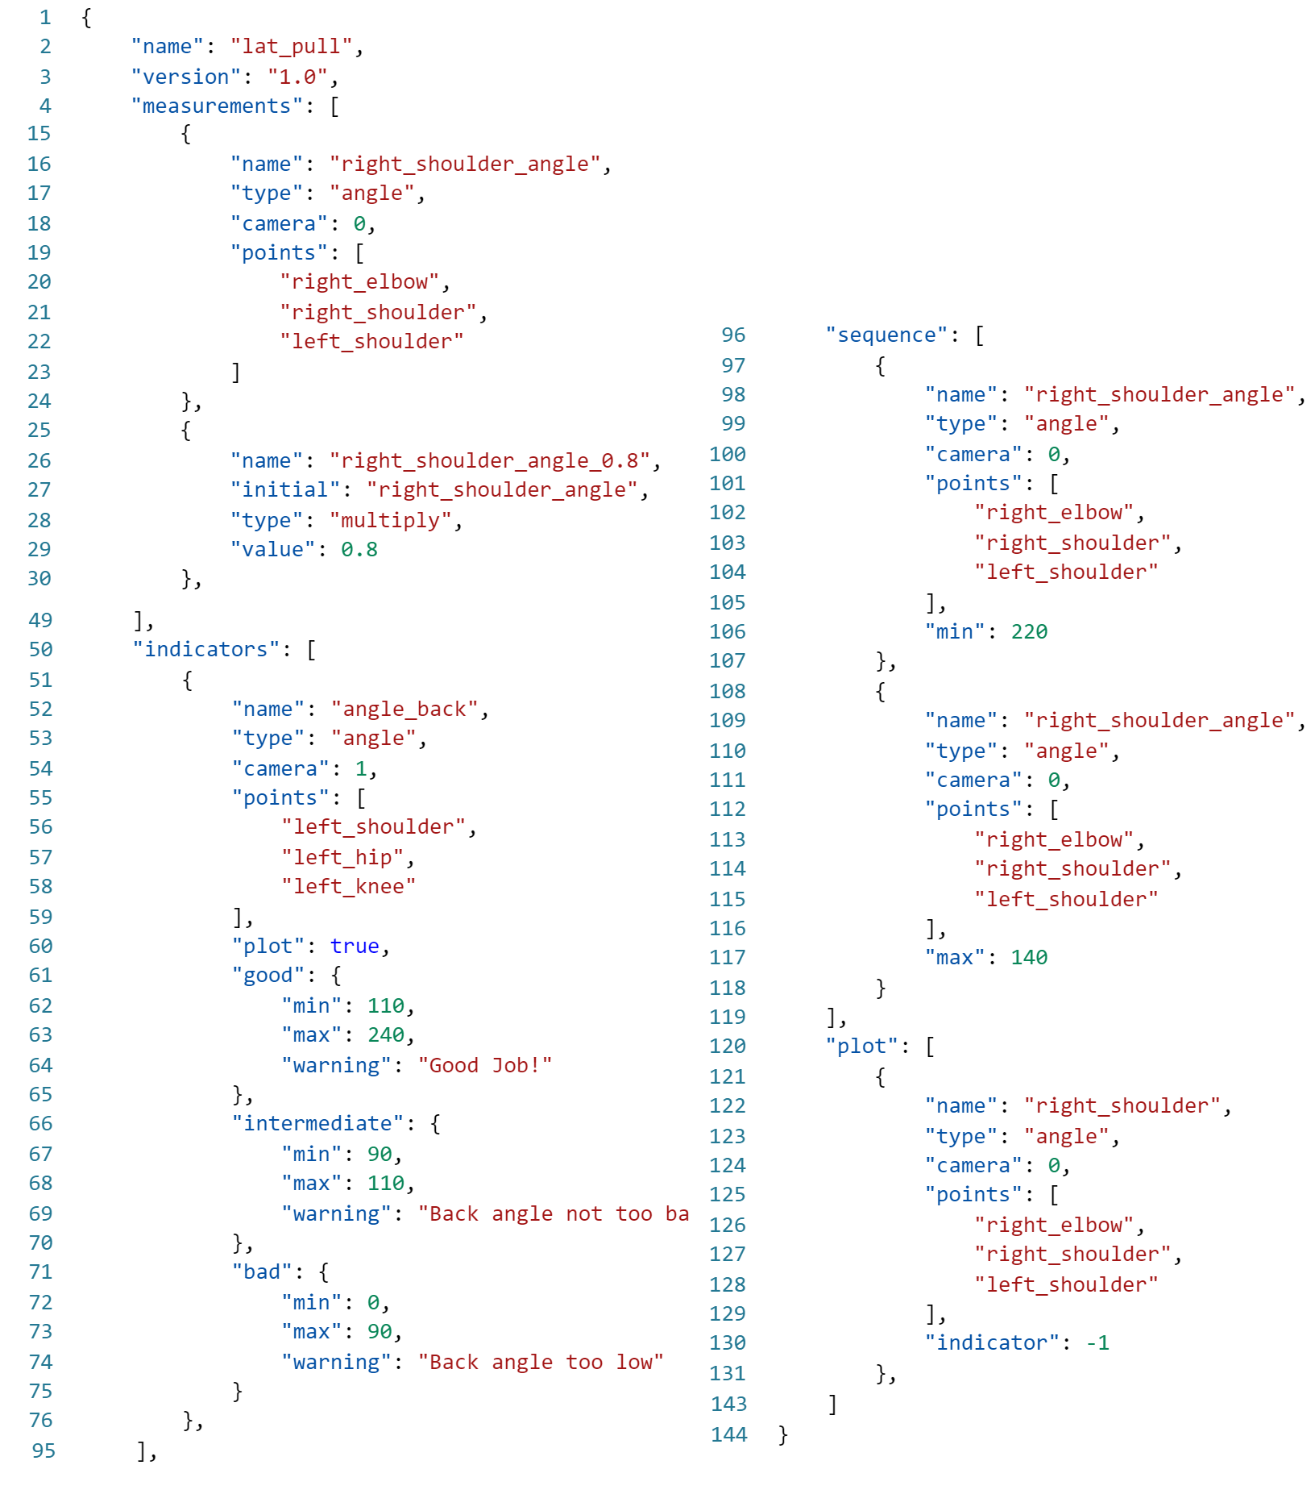
Specify no. of cameras
Measurements and computations
Indicators for tracking posture
Sequences for tracking reps
Additional plotting for visualization
Info for guiding/ warning the user.
Tight coupling with cameras
Platform independent.

Slide 6
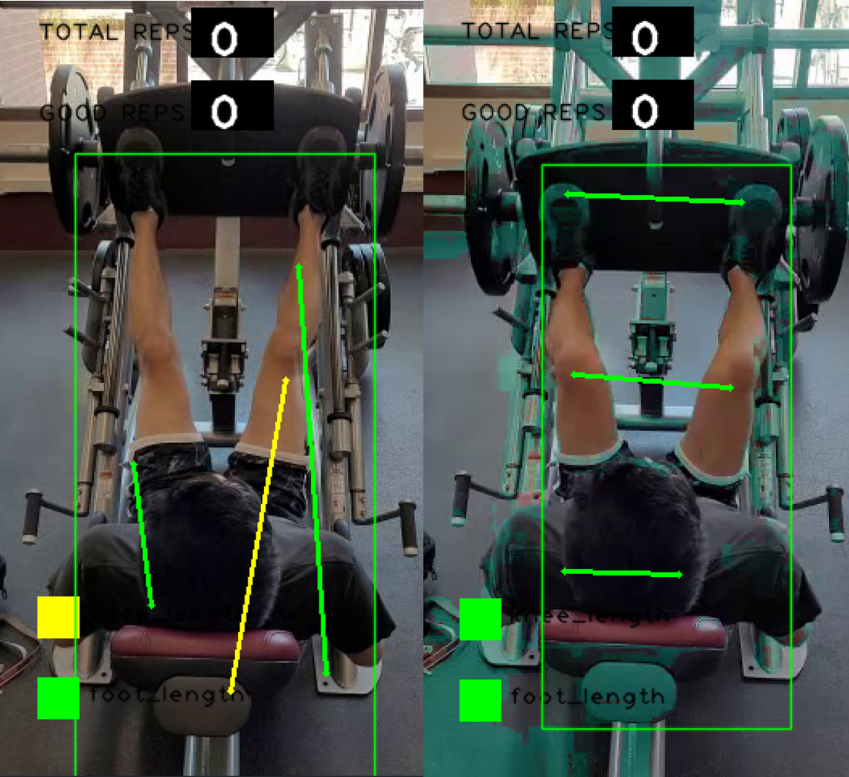
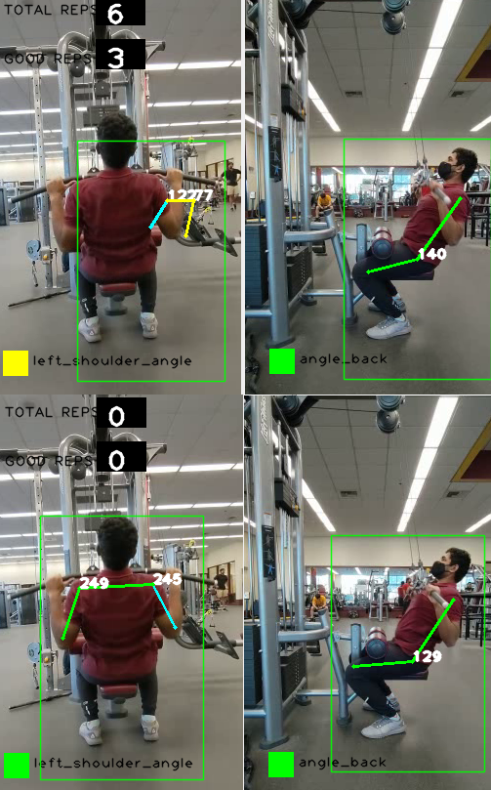
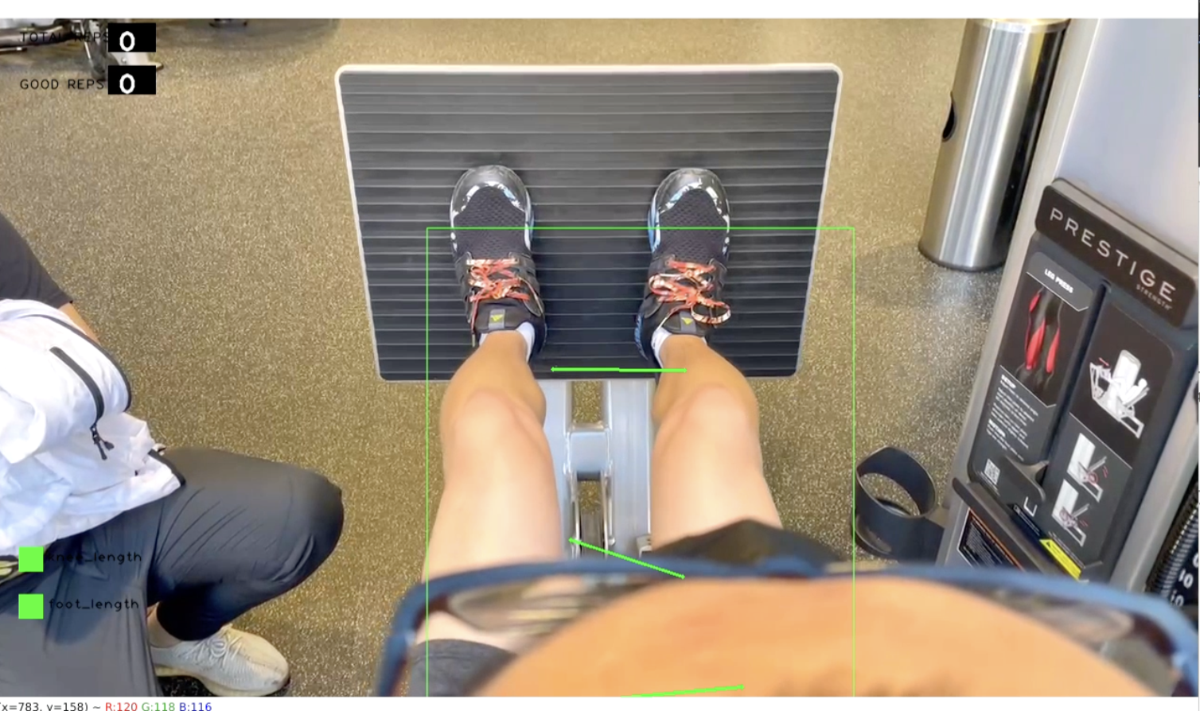
A few drawbacks of MediaPipe
Collecting

Slide 7
Machine Learning Results (Support Vector Machine)
LatPull | Precision | Recall | f1-score | Support
0 | 0.99 | 1.00 | 1.00 | 113
1 | 1.00 | 0.98 | 0.99 | 65
Accuracy | 0.99 |  |  | 178
Macro Avg | 1.00 | 0.99 | 0.99 | 178
WeightedAvg | 0.99 | 0.99 | 0.99 | 178
LegExtension | Precision | Recall | f1-score | Support
0 | 0.94 | 0.83 | 0.88 | 81
1 | 0.82 | 0.94 | 0.88 | 69
Accuracy | 0.88 |  |  | 150
Macro Avg | 0.88 | 0.88 | 0.88 | 150
WeightedAvg | 0.89 | 0.88 | 0.88 | 150
Squat | Precision | Recall | f1-score | Support
0 | 1.00 | 1.00 | 1.00 | 30
1 | 1.00 | 1.00 | 1.00 | 25
Accuracy | 1.00 |  |  | 55
Macro Avg | 1.00 | 1.00 | 1.00 | 55
WeightedAvg | 1.00 | 1.00 | 1.00 | 55
LatPress | Precision | Recall | f1-score | Support
0 | 0.96 | 0.96 | 0.96 | 52
1 | 0.97 | 0.97 | 0.97 | 72
Accuracy | 0.97 |  |  | 124
Macro Avg | 0.97 | 0.97 | 0.97 | 124
WeightedAvg | 0.97 | 0.97 | 0.97 | 124

Slide 8
Problems we faced
Collecting dataset for machine learning model
Synchronizing the videos recorded on different devices (apple/android)
Finding a common pattern for decoupling the heuristics and rep counter

Slide 9
Q & A?
Thank you

